Slide 1
Ancestor Mapper
A genealogy database that allows you to analyse your family history by location.
Amelia Longcroft
CFG Data & SQL Kickstarter Project, May 2024

Slide 2
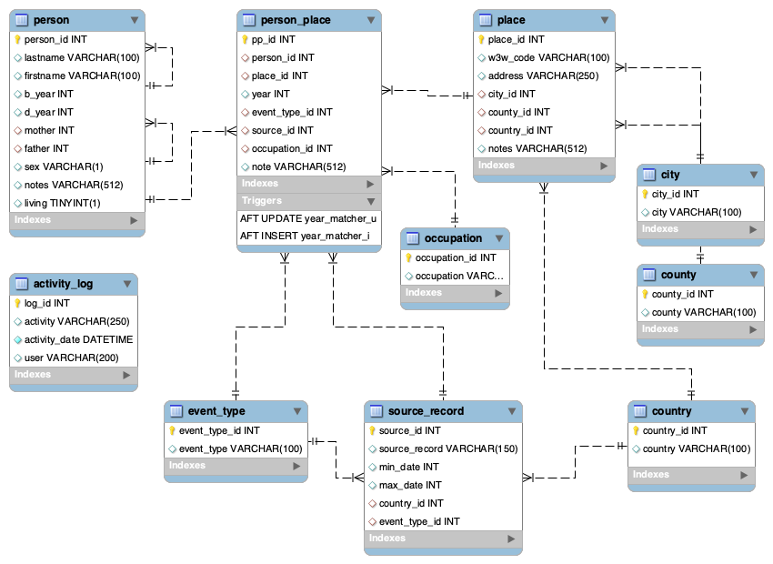
Database Structure
Base tables with a many to many relationship:
Person
place
Intermediate table to link base tables together:
person_place
Reference tables (after normalizing):
city, county, country
occupation
source_record
event_type
Audit table:
activity_log

Slide 3
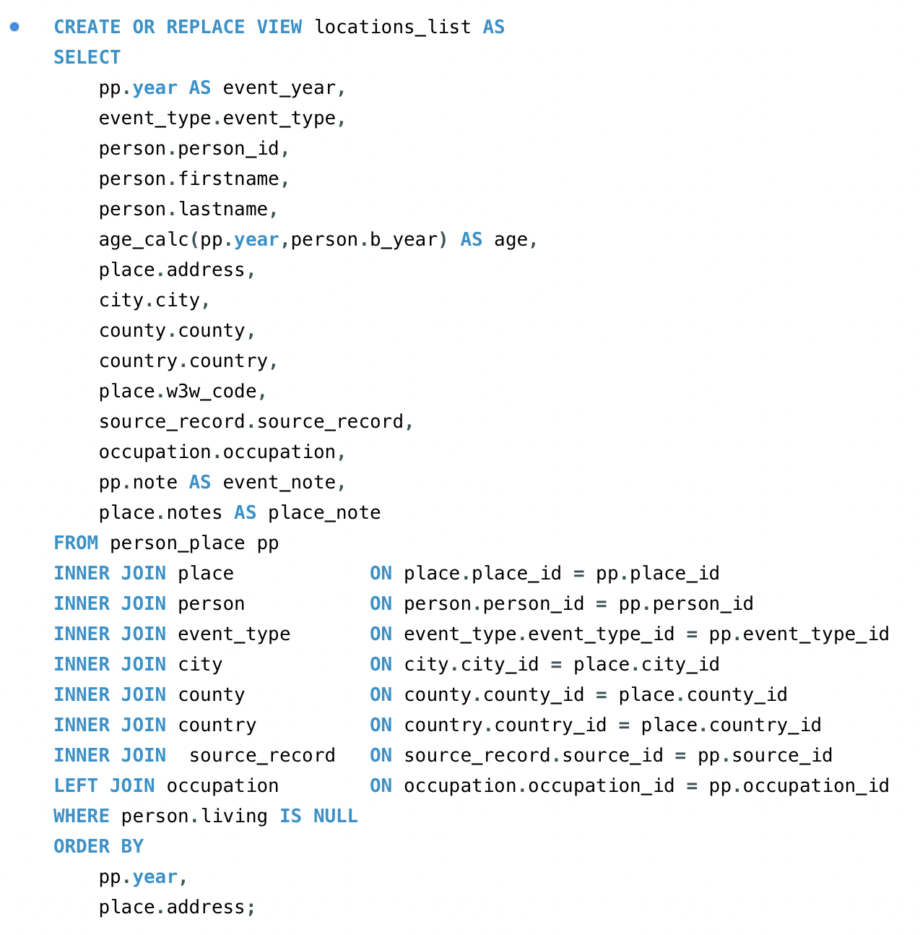
Joining the tables with a view
The query needed to get human-friendly output from my central person_place table is massive because of all the columns I want to include and all the joins required to connect the tables.
By creating a view I can avoid repeating this big block of code, and query the database more easily.

Slide 4
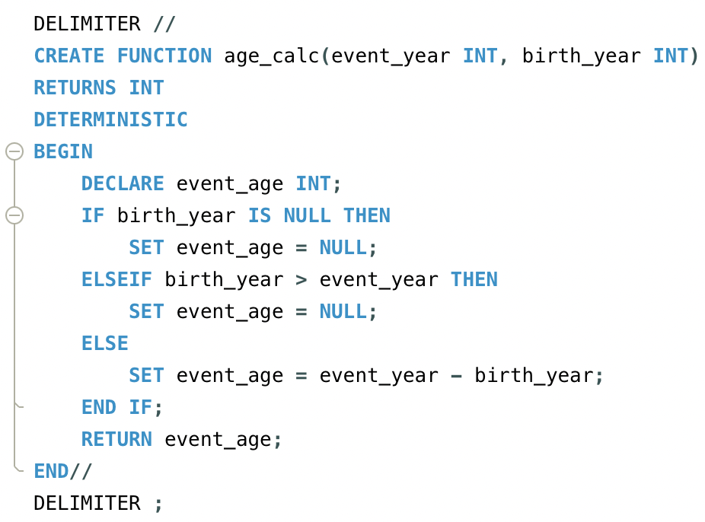
Using a stored function
Within the query I’ve used a stored function called age_calc which takes two parameters – event_year and birth_year – to calculate a person’s age:

Slide 5
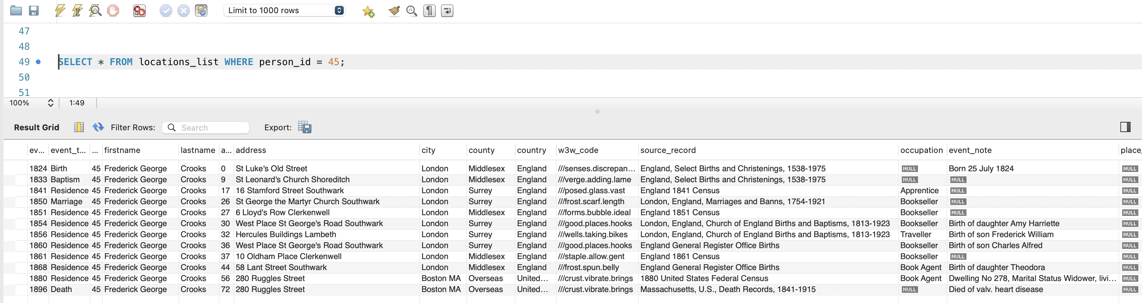
Using the view
Using a simple SELECT query on the locations_list view I can output a detailed geographical biography of a person (or people) showing where they were, what they were doing there, and where this data came from.

Slide 6
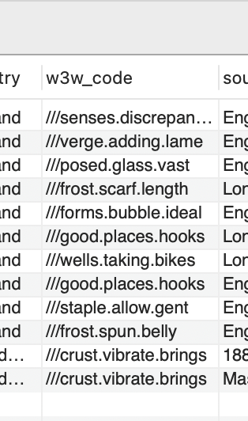
Using the view
The w3w_code column in the view stores What3Words location codes, which gives the potential to generate maps like this … not that I know how to do this (yet!)
What3Words Map

Slide 7
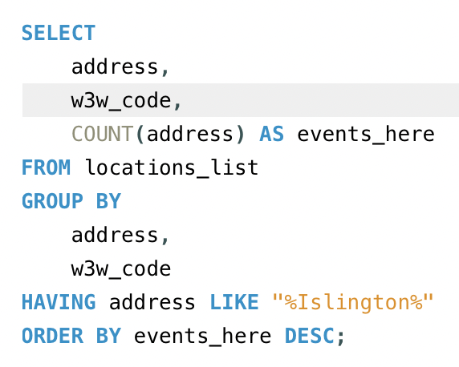
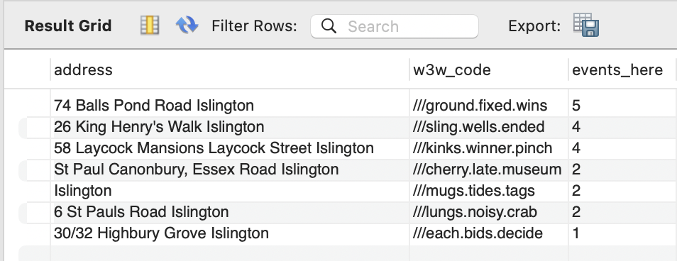
Group BY and having
The locations_list view can also be queried to output aggregated data.
For example, here I want to count the number of events at each place and filter the output to select only those places with Islington in the address.

Slide 8
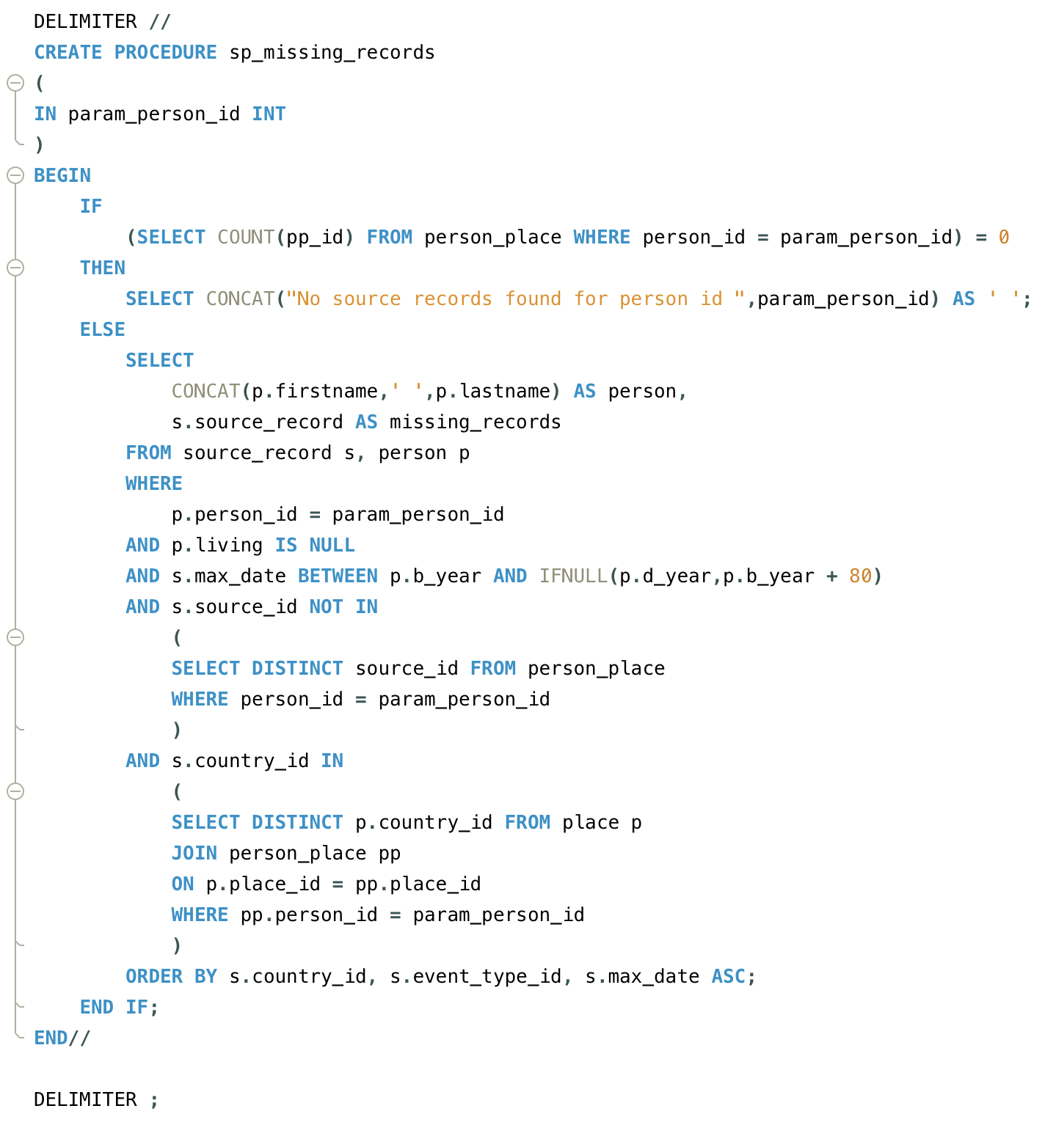
Stored procedure
So far the database is showing me detailed lists of the data I have for each ancestor.
But it’s also handy to look at what data I don’t have.
The stored procedure sp_missing_records takes person_id as the input parameter and returns a list of suggested source records that are not present in the person_place table for that person.

Slide 9
subqueries
I’ve used two subqueries in the stored procedure to:
exclude the sources that I already have for the person
only select the sources relevant to the country or countries the person lived in

Slide 10
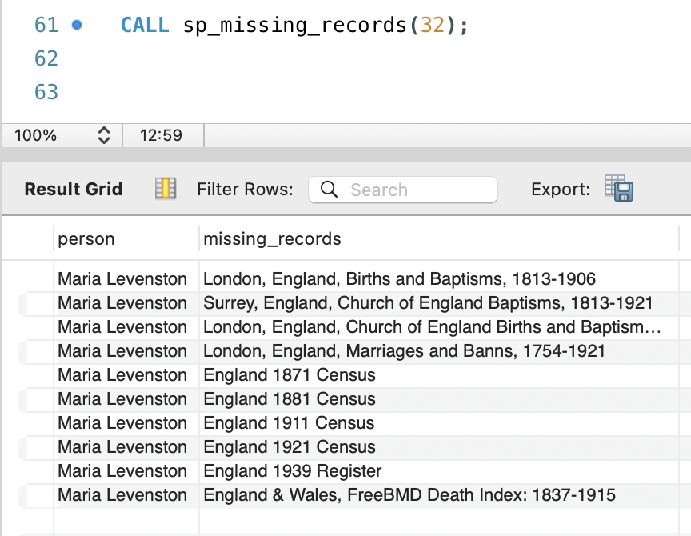
Stored procedure OUTPUT
Here’s the output when I call the stored procedure for my great-great-grandmother Maria Levenston showing a suggested list of records I don’t have.
This gives me a useful to do list for further research.

Slide 11
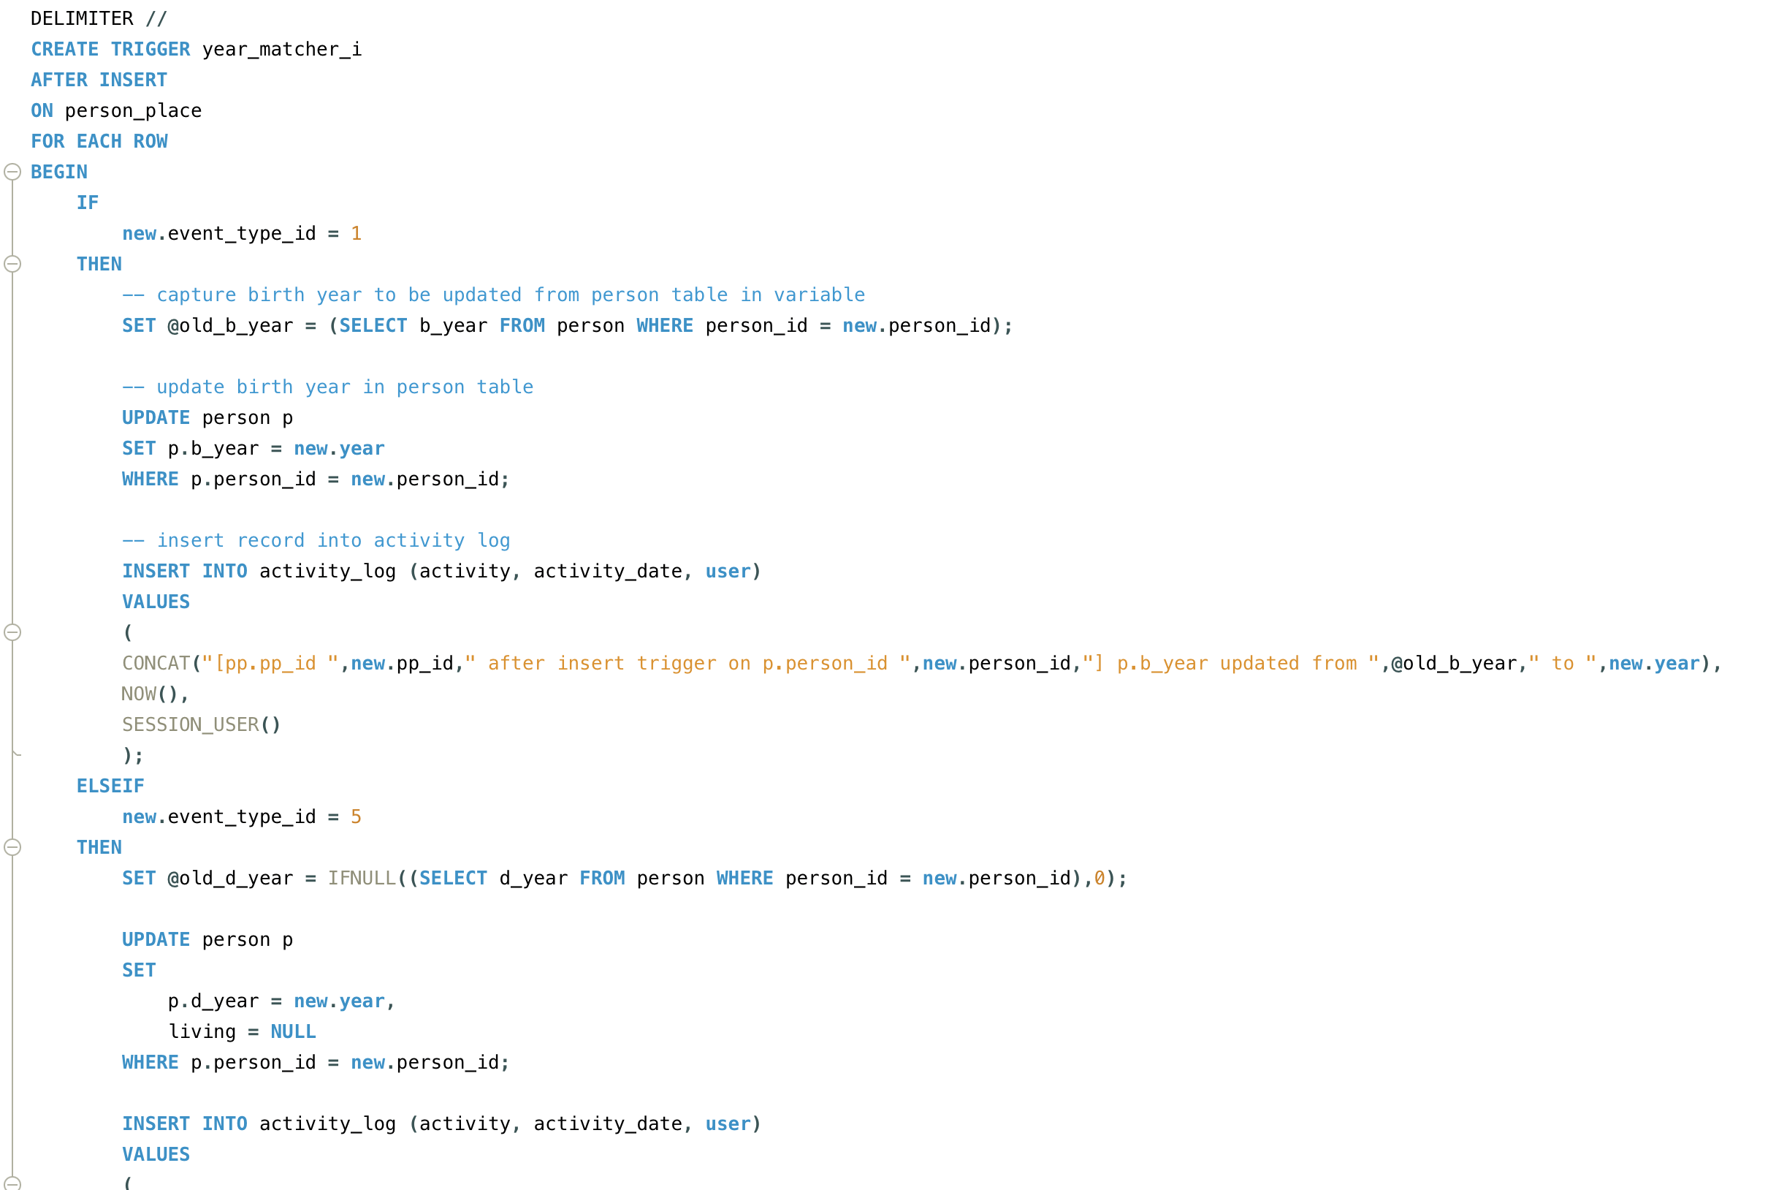
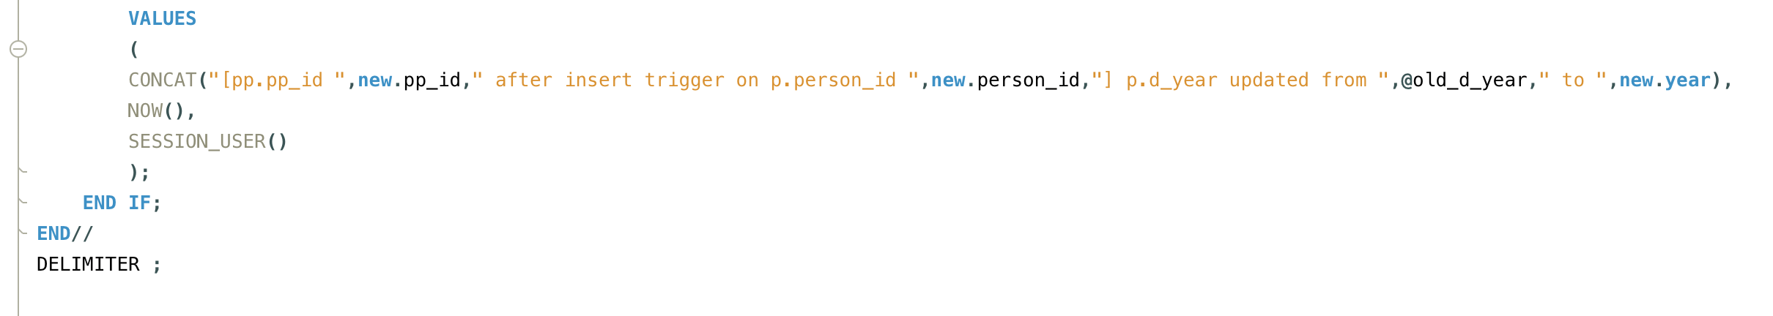
TRIGGERS
Insert and update triggers allow me to avoid potential data anomalies by updating the birth or death year in the person table when a birth or death event type is inserted into or updated in the person_place table to ensure that these values always match.
Any updates are recorded in the activity_log table.

Slide 12
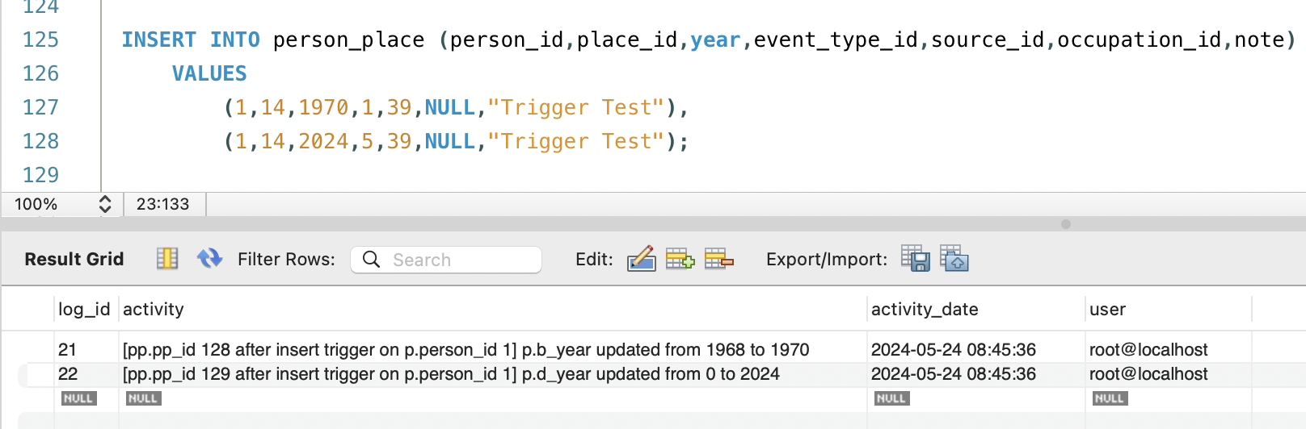
TRIGGERS
After inserting rows into person_place recording where and when a person was born and died, the insert trigger captures the updates it makes to the person table in the activity_log table, showing both previous and new values.

